Slide 1

Compliance Archiving

Slide 2


Introduction
ExchangeDefender Compliance Archive provides secure, long term storage, recovery and eDiscovery system that assures compliance with regulatory requirements established by IRS, HIPAA, SOX and SEC. Email has taken over faxes and phone calls as the leading communications platform and the importance of keeping a record of all the email communications is catching the scrutiny of local and federal government agencies.
There are only a couple of things that need to happen once you've ordered the product from our Service Manager.
Creating Your Journal Mailbox
Via Shell:
Name - EDJournal
User Principal Name - edjournal@yourdomain.com
Mailbox Database - Database1
After you enter the first command, you will be prompted for a password.
$password = Read-Host "Enter password" -AsSecureString
New-Mailbox -Name EDJournal -UserPrincipalName edjournal@yourdomain.com -Database "Database1" -
Password $password
Via EMC:
1. In the console tree, click Recipient Configuration.
2. In the action pane, click New Mailbox.
3. On the Introduction page, click User Mailbox.
4. On the User Type page, click New User.
5. On the User Information page, complete the following fields:

Slide 3
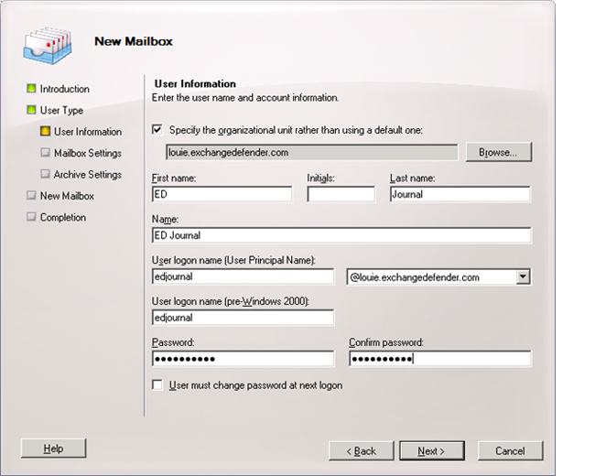
Specify the organizational unit rather than using a default one Select this check box to select an organizational unit (OU) other than the default (which is the recipient scope). If the recipient scope is set to the forest, the default value is set to the Users container in the domain that contains the computer on which the Exchange Management Console is running. If the recipient scope is set to a specific domain, the Users container in that domain is selected by default. If the recipient scope is set to a specific OU, that OU is selected by default. To select a different OU, click Browse to open the Select Organizational Unit dialog box. This dialog box displays all OUs in the forest that are within the specified scope. Select the desired OU, and then click OK.
First name, Initials, and Last name Because this mailbox will be used to collect journal reports, it isn't necessary to complete these fields.
Name Use this box to type a display name for the journaling mailbox. This is the name that's listed in Active Directory. By default, this box is populated with the names you enter in the First name, Initials, and Last name boxes. If you didn't use those boxes, you must still type a name in this field. The name can't exceed 64 characters.

Slide 4
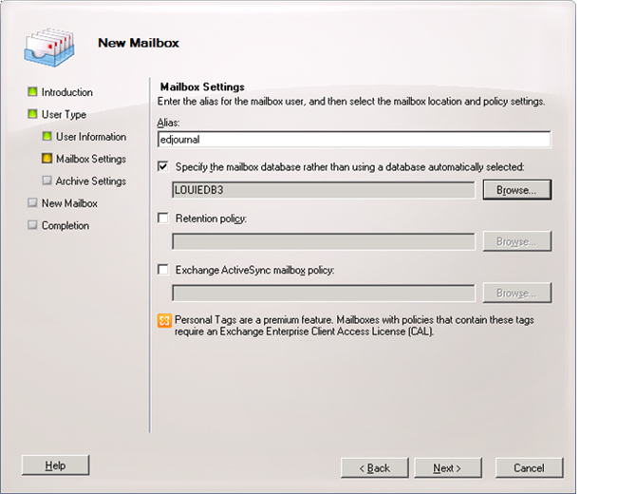
User logon name (User Principal Name) Use this box to type the name that the user will use to log on to the journaling mailbox. The user logon name consists of a user name and a suffix. Typically, the suffix is the domain name in which the user account resides.
User logon name (pre-Windows 2000) Use this box to type the name for the user that's compatible with the legacy versions of Microsoft Windows (prior to the release of Windows 2000 Server). This field is automatically populated based on the User logon name (User Principal Name) field. This field is required.
Password Use this box to type the password that the user must use to log on to the journaling mailbox
Confirm password Use this box to confirm the password that you typed in the Password box.
User must change password at next logon Please do not set this flag.
6. On the Mailbox Settings page, complete the following fields:

Slide 5
Alias - Use this box to type an alias for the journaling mailbox. The alias can't exceed 64 characters and must be unique in the forest.
Specify the mailbox database rather than using a database automatically selected - Select this check box to specify a mailbox database instead of allowing Exchange to select a database for you. Click Browse to open the Select Mailbox Database dialog box. This dialog box lists all the mailbox databases in your Exchange organization. By default, the mailbox databases are sorted by name. You can also click the title of the corresponding column to sort the databases by storage group name or server name. Select the mailbox database you want to use, and then click OK. This is an optional field.
Managed folder mailbox policy - Select this check box to specify a managed folder mailbox policy for the journaling mailbox. A managed folder mailbox policy is a logical grouping of managed folders. When a managed folder mailbox policy is applied to a user’s mailbox, all the managed folders that are linked to the policy are deployed in a single operation, thereby making the deployment of messaging records management (MRM) easier. To learn more, see Understanding Managed Folders.
Click Browse to open the Select Managed Folder Mailbox Policy dialog box. Use this dialog box to select the managed folder mailbox policy to be associated with this mailbox. This is an optional field.
Some third-party archiving or retention solutions retrieve journal reports from the journaling mailbox and store them in an external database, or require you to automatically forward a copy of the journal report to the external database or e-mail address. If you use a similar solution, and if it doesn't automatically purge messages from the journaling mailbox after retrieving them, the journaling mailbox may continue to grow and consume storage space. You can create a managed folder mailbox policy and apply it to the journaling mailbox to automatically purge messages after a certain period.
Exchange ActiveSync mailbox policy - Journaling mailboxes are meant to be accessed using Microsoft Exchange ActiveSync. You don't need to select this option when creating a journaling mailbox.
7. On the Archive Settings page, leave the Create an archive mailbox for this account box checked.
8. On the New Mailbox page, review your configuration settings. To make any configuration changes, click Back. To create the journaling mailbox, click New.
If you did not create the Journal Mailbox to journal at the Mailbox Database level you'll need to add the desired security groups or users to the OU you set up as being journaled in the beginning of Step 5. This can be managed by your "Active Directory Users and Computers".

Slide 6
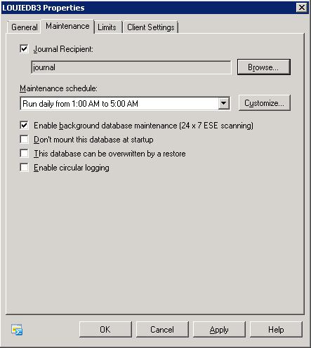
Creating per Mailbox Database Journaling
Via EMC:
1. Navigate to Organization Configuration > Mailbox.
2. In the result pane, click the Database Management tab, and then click the mailbox database on which you want to enable journaling.
3. In the action pane, under the mailbox database name, click Properties.
4. In < Mailbox Database > Properties, click the Maintenance tab.
5. Select the Journal Recipient check box, and then click Browse.
6. In Select Recipient, select the recipient that will receive the journal reports, and then click OK

Slide 7
Via Shell:
This example enables journaling for the mailbox database User Database and sets Sales Database Journal Mailbox as the journal recipient. TheJournalRecipient parameter specifies the secured e-mail mailbox to which journal reports are sent.
Set-MailboxDatabase "User Database" - JournalRecipient "Sales Database Journal Mailbox"
Creating per Mailbox Database Journaling
Via EMC:
1. In the console tree, navigate to Organization Configuration > Hub Transport.
2. In the result pane, click the Journal Rules tab, and then in the action pance, click New Journal Rule.
3. On the New Journal Rule page, complete the following fields:
Rule Name - Type a name for the journal rule.
Send Journal reports to e-mail address - Click Browse. In the Select Recipient window, select the recipient that will receive the journal reports.
Scope - Select the scope to which the journal rule should be applied. The following scopes are available: Global - Global rules process all email messages that pass through a Hub Transport server. These include messages that may have already been processed by internal rules and external rules. Internal - Internal rules process email messages sent and received by recipients in the Exchange 2010 organization.External - External rules process email messages sent to recipients or sent from senders outside the Exchange 2010 organization.
4. Click New to create the journal rule.
5. On the Completion page, review the following, and then click Finish to close the wizard:
A status of Completed indicates that the wizard completed the task successfully.
A status of Failed indicates that the task wasn't completed. If the task fails, review the summary for an explanation, and then click Back to make any configuration changes.

Slide 8
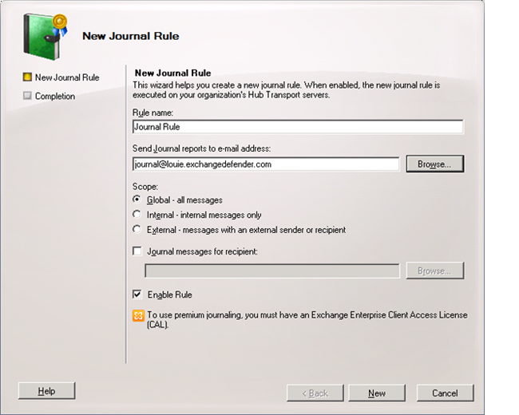
Via Shell:
This example creates a journal rule to journal all messages sent to and received by the recipient user1@domain.com.
New-JournalRule -Name "Discovery Journal Recipients" -Recipient user1@domain.com -JournalEmailAddress "Journal Mailbox" -Scope Global -Enabled $True

Slide 9
Final Step
Once you have chosen and completed your deployment path please provide us with the following information:
Your server's Web Services URL, generally it follows this convention: https://your.server.com/ews/exchange.asmx
Your journal accounts Windows Domain.
Your journal mailbox's username.
Your journal mailbox's password.
Once you have completed the deployment your emails will be found at https://compliancearchive.exchangedefender.com

