Slide 1
Support Portal Walk-Through

Slide 2
Portal Walk Through
This guide was designed to walk you through the most important aspects of our support portal. Our support portal is a centralized location where you can:
Update Company and Contact Information for your business
Review billing items, such as invoices and current services
Order new services
Request support for any of our products
Browse our expansive Knowledge Base library
And so much more...
Accessing The Portal
The first step in gaining access to the support portal is to log into the portal which is located at:
https://support.exchangedefender.com.
Your credentials were revealed to you on the partner application screen and emailed to you directly once you successfully completed the Partner Program application. If you've forgotten your password, please click on the "Forgot password?" link on this page since we cannot provide this information over the phone. This process is implemented to protect the integrity of your account information. Following this procedure will send an email with your password directly to your inbox.
In addition to being SAS70 Type II certified our website is protected by 128 BIT SSL security, which is the same level of security the banking industry employs.

Slide 3
Understanding the Support Portal Home Dashboard
The Support Portal dashboard is divided into multiple sections; as we move through this guide will there will be an in-depth breakdown of each and every one of them. Please review the legend below for an explanation for what each portion of the portal's "Welcome Dashboard" can do below:
1. Menu Bar - This menu bar will display multiple menus within the portal and gives you the ability to navigate through all of the portal's features. Some of those features include:
Support - This menu provides the ability to open, update, document, and close support requests. These requests are all handled personally by our engineers 24/7/365 and are bound by our SLA found at the bottom of every page.
Company - This menu provides the ability to manage, update, and view company specific details such as: billing information, current services, invoices and your support history.
Knowledge Base - This menu will take you to our expansive knowledge base library and offer assistance with known issues, custom deployments and work arounds for all of our services.
Community - This menu gives you the ability to submit bug reports and track their progress as well as submit a Feature Request. During the Development Cycle our CEO and Lead Designer utilize feedback provided by our partners and implement these features directly. If you feel there is something of value, it is a "must have" for any of our products, this is the place to voice it.
Options - This menu allows you to view and/or edit your individual account's contact information.
Service Manager - The Service Manager is probably the single most important aspect of the Menu Bar. Access to the Service Manager gives you the ability to create, manage, and remove specific services through our proprietary API. This allows you to manage or be directly linked to all of your services from one page.
2. Announcements - Here you will find a variety of up to the minute important information. This information can include everything from business announcements (product releases, major bug fixes, event accouchements, etc.) to support announcements (outages, maintenance, anything that may be impact our services).
3. Services Signup - Here you can order all of the Services we have available at the single click of a button.
4. Links - This section links the portal to other support and community resources for all of our partners.
5. Search/Create Box - This box allows you to Search the portal for any string and if you use the "New" drop down you can add contacts/employees, as well as create new support requests.

Slide 4
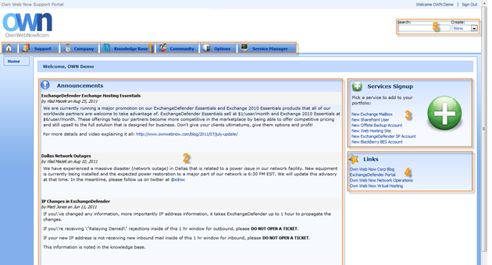
This section of the guide provides detailed information on the multiple functions of the Welcome Dashboard.

Slide 5
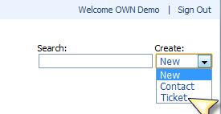
Understanding the Support Portal Home Dashboard
There are two simple ways to do this:
1. You can click on the Search/Create drop down and select Ticket.
2. Or you can click on Support, then "Create New".
Once this process has been completed you can provide your ticket information to receive support. As shown below there are a few categories that will help us provide you with prompt and courteous assistance:
Email - This will be prefilled for you and pulled from your Support Portal account.
Category - Here you'll choose the type of request (Support, Billing, etc.).
Priority - These priorities allow you to set the expected response time based on the SLA found at the bottom of every page.
Subject - A brief description of the issue (there is a character limit so please provide details in the comments section.
Comments - This is the portion of the ticket where you'll provide the details of your report. Please provide detailed facts and documentation to ensure fast and accurate response times. When making reports regarding email flow, items such as NDRs and headers prove invaluable. By the same token, when reporting issues with our GUI, Outlook or OWA, screenshots are truly worth a thousand words. The more information up front the less information we'll need to resolve or research your inquiry.

Slide 6
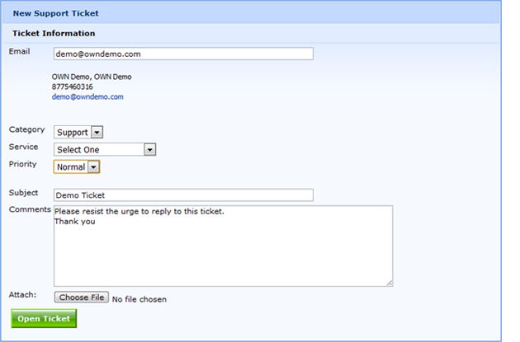
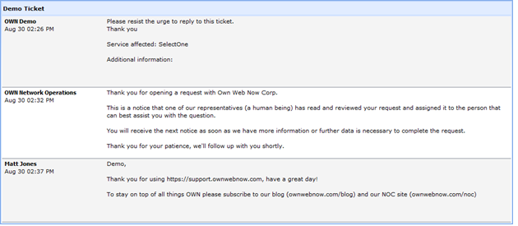
Once you submit your support request it's in the hands of our engineers for review. Any updates that require additional information or provide a resolution will be emailed to you directly but ultimately if you have an outstanding issue nothing beats the portal itself in speed and efficiency.
Note: After submitting a request it's always a good idea to view what is actually submitted. Often time's items with special characters are omitted due to security risks, please double check your request to ensure that all of the information is included.
Once you have submitted your request, you'll be presented with the Ticket View screen, this view will show your information as well as any updates we provide to your issue. Should you leave this view, you can always return by clicking on "Support", then the desired ticket.

Slide 7
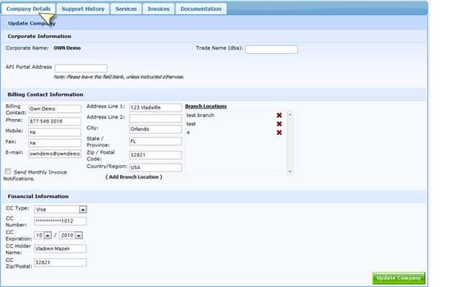
Company Tab
Company Details
This sub-tab will allow you to view and edit your company's DBA (should that change), Billing Contact Information, Branch Locations, Invoice Notification Settings, and credit card information.
Support History, Services, and Invoices
This tab will capture every single ticket your company has opened with us. This is a great tool to use to track down a repeat issue with a simple solution or just to find a specific issue you need to reference for any other purpose. The same compilations are available for Services and Invoices.

Slide 8
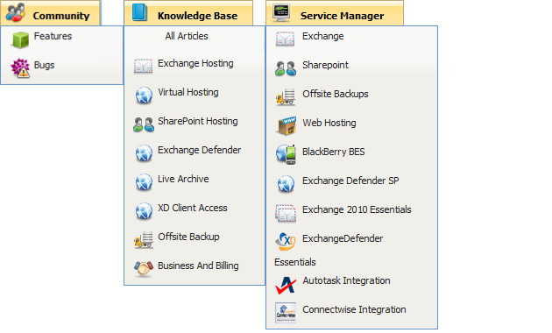
Community, Knowledge Base, and Service Manager
Community
This menu gives you the ability to submit bug reports and track their progress; in addition you may also submit Feature Requests. During the Development Cycle our CEO and Lead Designer utilize feedback provided by our partners and implement these features directly. If you feel there is something of value, it is a "must have" for any of our products, this is the place to voice it.
Options
This menu allows you to view and/or edit your individual account's contact information.
Service Manager
The Service Manager is probably the single most important aspect of the Menu Bar. Access to the Service Manager gives you the ability to create, manage, and remove specific services through our proprietary API. This allows you to manage or be directly linked to all of your services from one page.

